Slide 1

BSSE -Software Quality Engineering
Week-5 Lecture 9
Semester 6- Fall 2020

Slide 2
SOFTWARE TESTING

Slide 3
SDlC(Software Development Life Cycle)
Standard model used word wide to develop a software.
A framework that describes the activities performed at each stage of a software development project.
Necessary to ensure the quality of the software.
Logical steps taken to develop a software product.

Slide 4

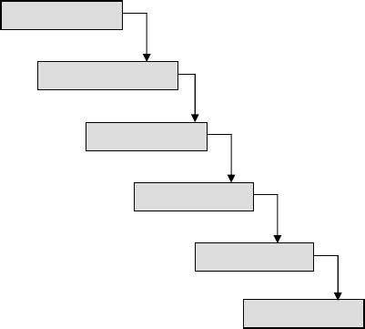
Feasibility Study
Requirements Analysis & Specification
Design
Coding & Unit Testing
Integration & System Testing
Maintenance
It is the oldest and most widely used model in the field of software development.

Slide 5
Testing Life Cycle
Project Initiation
Summary Reports
System Study
Analysis
Test Plan
Regression Test
Design Test Cases
Report Defects
Execute Test Cases ( manual /automated )

Slide 6

It is a systematic approach to test a system i.e. software. The plan typically contains a detailed understanding of what the eventual testing workflow will be.

Slide 7

Test Case
It is a specific procedure of testing a particular requirement.
It will include:
Identification of specific requirement tested Test case success/failure criteria
Specific steps to execute test
Test data

Slide 8






Black box testing
White box testing

Slide 9
Black box testing
No knowledge of internal program design or code required.
Tests are based on requirements and functionality.
White box testing
Knowledge of the internal program design and code required.
Tests are based on coverage of code statements, branches, paths, conditions.

Slide 10




Black box testing
requirements
output
input
events

Slide 11



White box testing
Test data
Tests
Derives
Component code
Test outputs

Slide 12
Testing Levels
Unit testing
Integration testing
System testing

Slide 13
UNIT TESTING
Tests each module individually.
Follows a white box testing (Logic of the program). Done by developers.

Slide 14



Once all the modules have been unit tested, integration testing is performed.
It is systematic testing.
Produce tests to identify errors associated with interfacing.
Types:
Big Bang Integration testing Top Down Integration testing Bottom Up Integration testing Mixed Integration testing

Slide 15


The system as a whole is tested to uncover requirement errors.
Verifies that all system elements work properly and that overall system function and performance has been achieved.
Types:
Alpha Testing Beta Testing
Acceptance Testing Performance Testing

Slide 16
Alpha Testing
It is carried out by the test team within the developing organization .
Beta Testing
It is performed by a selected group of friendly customers.
Acceptance Testing
It is performed by the customer to determine whether to accept or reject the delivery of the system.
Performance Testing
It is carried out to check whether the system meets the nonfunctional requirements identified in the SRS document.

Slide 17
Types of Performance Testing:
Stress Testing Volume Testing Configuration Testing Compatibility Testing Regression Testing Recovery Testing Maintenance Testing
Documentation Testing Usability Testing

Slide 18
DISCUSSION
In order to be cost effective, the testing must be concentrated on areas where it will be most effective.
The testing should be planned such that when testing is stopped for whatever reason, the most effective testing in the time allotted has already been done.
The absence of an organizational testing policy may result in too much effort and money will be spent on testing, attempting to achieve a level of quality that is impossible or unnecessary.

